Slide 1
DevOps Intro How to become a power user
Notes:
Ice breaker game/questions?
Cati sunteti studenti?
Cati sunteti in an terminal?
Cati dintre voi sunteti angajati si din ce an? Part time sau full?
Avem vreun DevOps printre voi?

Slide 2
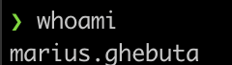
WhoAmI
8y experience in IT
4y experience as DevOps
2y in Nagarro
Mentored the first DevOps Internship in Nagarro
AWS Certified
Kubernetes Certified
RedHat Certified

Slide 3
Agenda
Why Nagarro?
Remote Learning and Internship
What is DevOps?
Roadmap
What are containers?
What are Clouds made of?
Cloud Security
What is CICD?
Learning Hacks
Portability
Productivity

Slide 4
- Tech Communities - Provides support on your learning path/career path - Plenty of projects to choose from with latest and greatest tech - All kinds of events (TB, Wine tasting, Community events, Parties, Back to school, etc.) - Attending conferences - Flexibility (WFH, WFA) - “The StartUp experience without the drawbacks”
Why Nagarro?

Slide 5
Remote Learning & Internship
Remote Learning(15-20w):
Java
C#
WebDev
C++
Summer Internship(6-10w):
UI/UX
Business Analyst
Mobile Apps
Mobile Apps Testing
DevOps
Weekly meeting with mentors
Documentation and assignments
Continuous feedback
Emulating project work
Best practices
Latest & greatest tools
Nagarrian mentors
Goal: Students upskill and ocassionally career shifting

Slide 6
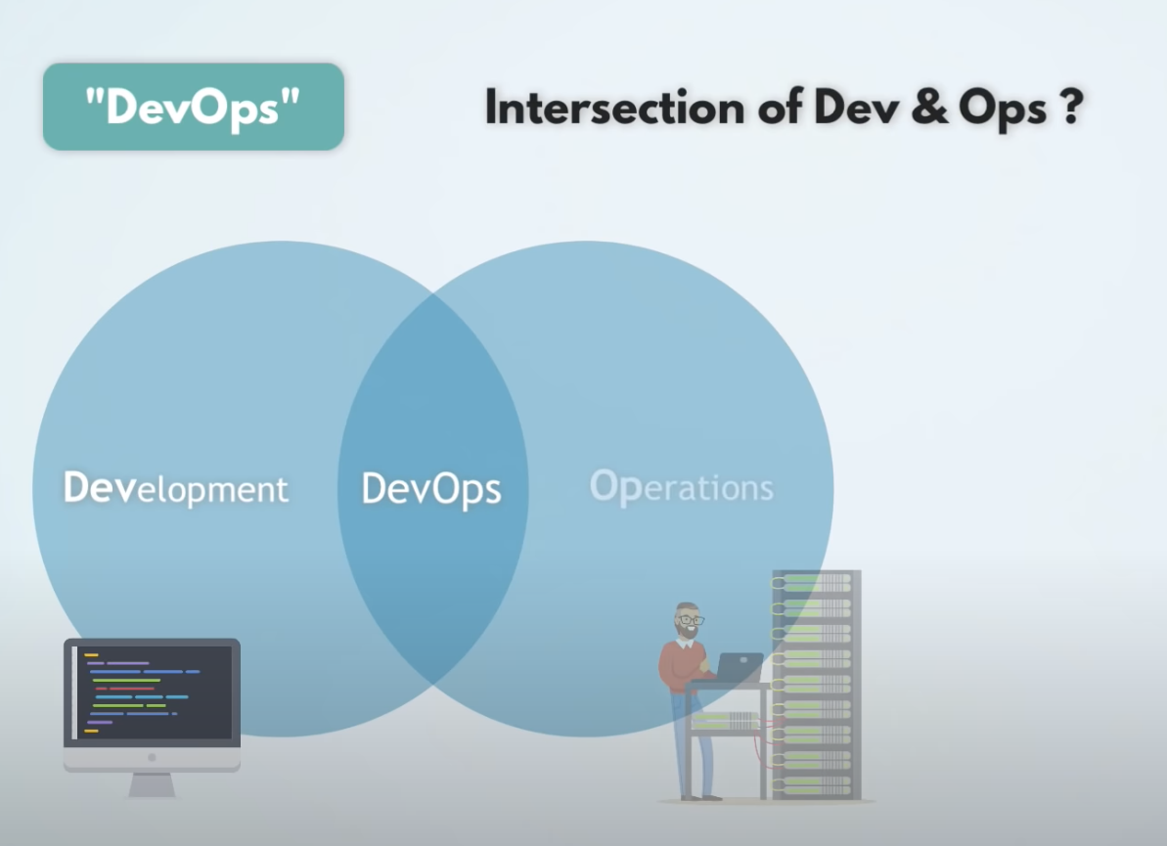
What is DevOps?
“Jack of all trades, master of none”
Recommendation:
Develop a skill (Ops or Dev) vertically
and then scale horizontally.
Notes:
DevOps history & tech advancing fast
qq: Cati dintre voi ati auzit de DevOps si ce nevoie credeti ca acopera?
in 2008 a aparut termenul de Devops.
la inceput trebuia sa fie scris mult mai mult cod pentru automaziari
mult mai inventivi in solutii
Inseamna ca DevOps moare?! Nu, in fiecare an apar concepte noi (vezi shift left), sau noi arii ale DevOps-ului vezi DevSecOps.
+ ca este un ocean de solutii software care trebuiesc administrate/implementate
- devops scope: (AWS Well architectured framework pillars)
qq: Care credeti ca sunt unele din cele mai uzuale tehnologii pe care ar trebui sa le stie un devops?

Slide 7
DevOps RoadMap
# | DevOps Tracks
1 | Networking
2 | Linux
3 | Programming
4 | Monitoring
5 | Logging
6 | Cloud
7 | Containerization
8 | CICD
9 | IaC/Configuration Management
10 | Git*
https://roadmap.sh/devops
https://landscape.cncf.io/

Slide 8
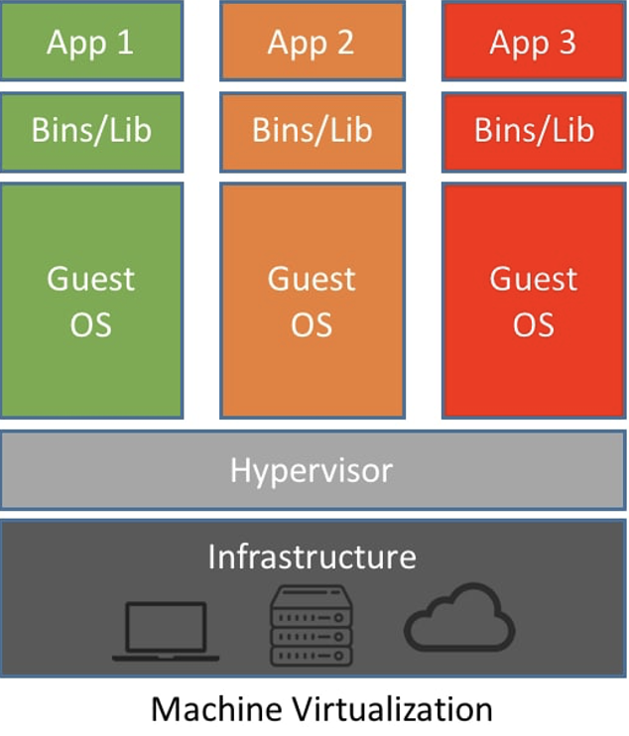
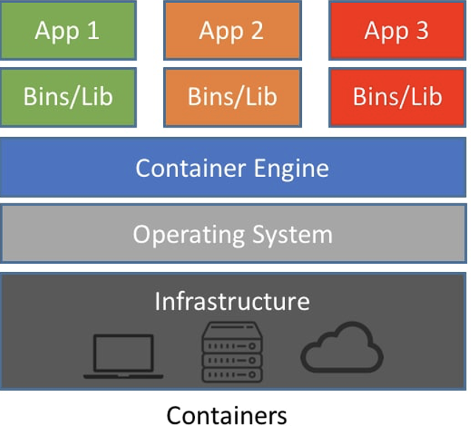
What are containers?
Notes:
cine a folosit docker?
Multi stage builds
showcase devops-webapp-sample github action

Slide 9
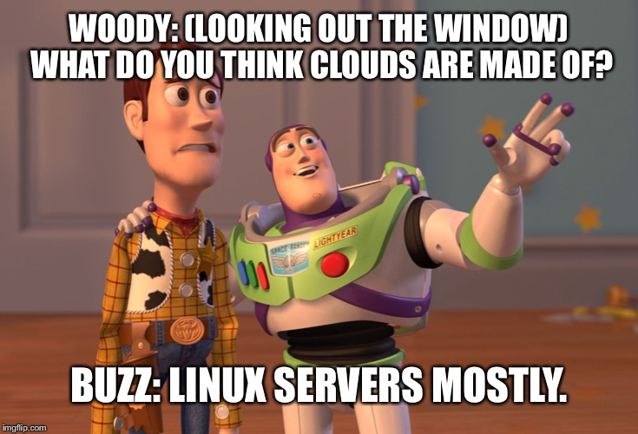
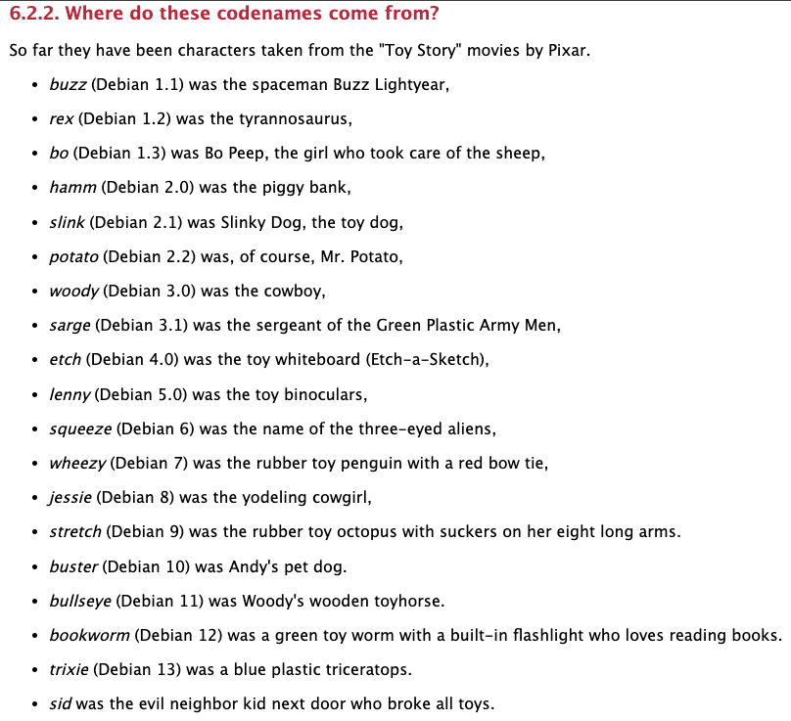
What are Clouds made of?
Fun fact:
- Debian distros are named after Toy Story characters.
Short answer: Managed services
Notes:
Cloud:
private, public, community, hybrid clouds
aws the first public cloud @2000
unused hardware story
qq: Sunt printre voi care ati avut conturi de Cloud free trial?

Slide 10



Security
Security recommendations in the Cloud:
Strong password for root user.
Enable MFA.
Password expiration for users.
Prevent password re-use.
Use instance profiles/roles to manage permissions for users and AWS services.
Create another user with the right permissions for your daily endeavours.
The Principle of Least Privilege.
Rotate passwords and API Keys.
Shared responsibility model.
Check Trusted Advisor and Security Hub.
Keep up to date with security threats .
Do not push credentials in git!!!
Watch out it can get expensive quickly!
Notes:
200k story, garsoniera in cluj.

Slide 11
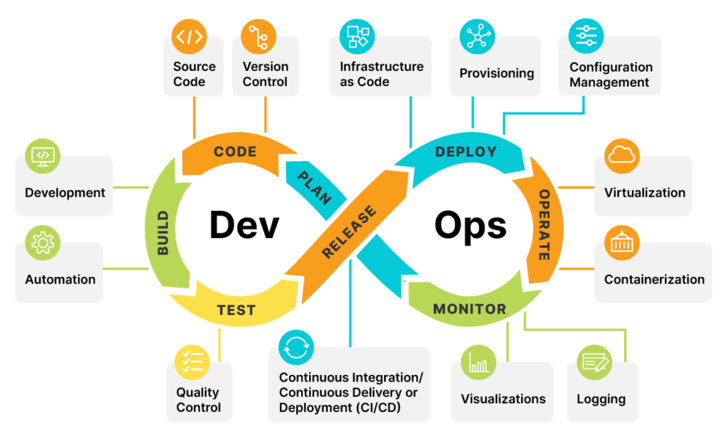
What is CICD?
CI - Continuous Improvement
Continuous Improvement → is the part which takes care of shipping quality code fast by leveraging tests, builds all bundled in the magic of automation.
CD - Continuous Deployment/Delivery
Continuous Deployment → is the process of moving software that has been built and tested successfully into production.
Continuous Delivery → is an approach which incorporates the concepts of continuous integration, automated testing and continuous deployment.
The difference between continuous delivery and deployment is that business teams may decide not to release software into production with continuous delivery due to various reasons.

Slide 12
Learning hacks
Give yourself time
Participate in challenges
https://adventofcode.com/
Capture the flag events
https://codeforces.com/problemset?order=BY_RATING_DESC
Make it fun by playing games
https://www.hackerrank.com/domains/shell (Linux)
https://www.openvim.com/ (VIM - Linux Text Editor)
https://cssbattle.dev/ or https://flexboxfroggy.com/ (CSS – Frontend)
https://learngitbranching.js.org/ (Git concepts)
Your system is powerful enough. Use free online sandboxes
https://www.docker.com/play-with-docker/ (Docker)
https://training.play-with-kubernetes.com/kubernetes-workshop/ (Kubernetes)
Make it fun
Be consistent

Slide 13
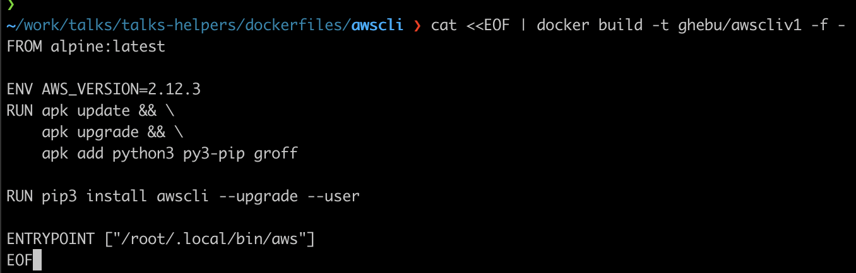
Portability
Docker run or brew install?!
CICD for pet projects
Github actions
Ephemeral Jenkins
https://github.com/marcel-dempers/my-desktop/tree/master/dockerfiles
https://youtu.be/acIntRLxxm0

Slide 14
Productivity
Tools:
Tmux - <insert Matrix meme here>
Rectangle (MacOS)
ZSH Plugins
git
zsh-autosuggestions
zsh-syntax-highlighting
WSL (Windows Sub System for Linux)
RSS Feed (i.e Feedly) – Control the information you consume
KeyClu
Sourcetree (Git Helper/GUI)
Github Projects/Trello/gqueues,etc
Browser plugins (Vimium, etc)
Shortcuts:
Touchpad gestures
Using virtual desktops
Clipboard history
Shell shortcuts
Browser shortcuts
Personal favorites:
- Touch Typing Games

Slide 15
Productivity – Fake it ’till you make it
docker run --rm -it bcbcarl/hollywood

Slide 16
Recommended Youtube Channels
Recommended YT Channels:
TechWorld with Nana
Network Chuck
DevOps ToolKit
That DevOps Guy

Slide 17

Q&A
Thank you for you attendance!
“Act like you’re 35!”
GitHub Links:
https://github.com/ghebu/noaptea-companiilor23
https://github.com/ghebu/MariusLaboratory

Slide 18
Appendix

Slide 19
Terraform Recommendations
Terraform Remote State
Versioning
Harden the S3 Bucket with IAM/ACL policies.
Backend config during terraform init
Keep it as DRY as possible
Abuse the TF conditionals
For_each
Count
Dynamic blocks
Ternary operators
Develop it with reusability in mind

Slide 20
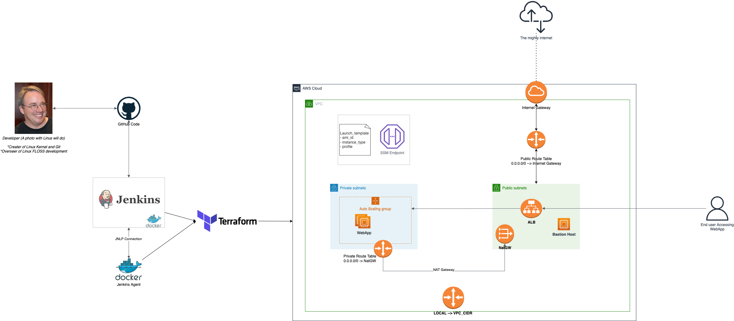
“Thou Art Demo God”

